Slide 1


Autonomous grading system for Sinhala Language Essays of grade 5 students
R24-088
R24-088

Slide 2


Content
Introduction
Research Question
Objectives
System Overview Diagram
Technologies
Individual Components Section
System requirements
Gantt Chart
Commercialization Aspects
Appendix

Slide 3



1.Introduction
Highlight the significance of an autonomous grading system in evaluating Sinhala essays of grade 5 students
Remedy for the challenges faced in traditional manual grading processes
Specific focus on Sinhala language and importance of addressing language proficiency
3

Slide 4

2. Research Problem
How to provide mobile application based solution on ,
autonomous grading system for Sinhala Language Essays of grade 5 students ?
4

Slide 5
3.Objectives
Main Objective
Create a grading system for Sinhala Language essays of grade 5 students
Sub Objectives
Identifying native words and replace them with more generic words
Misspelled Words Detection and Correction
Check the Grammar rules in the sentence
Provide general feedback by improving the answer
5

Slide 6
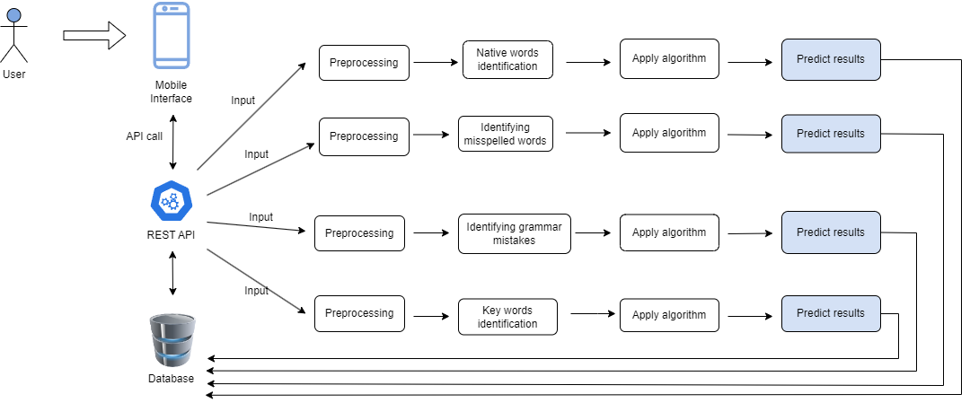
4. System Overview Diagram
4. System Overview Diagram
6

Slide 7

5.Technologies
Mobile Application
Android
Database
SQLite
Middle Ware Technologies
Python
TensorFlow
REST API
Technical Concepts
Natural Language Processing
Machine Learning
7

Slide 8
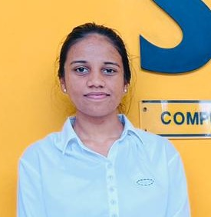
IT21007538 | Maddumage P.W.
BSc (Hons) Degree in Information Technology (specialization in Data Science)
IT21007538 | Maddumage P.W. | R24-088
8

Slide 9

Component 1
Identifying native words and replace them with generic words
IT21007538 | Maddumage P.W. | R24-088
9

Slide 10
Background
Native words, often specific to a particular region, can pose challenges in terms of comprehension and universality.
Process involves recognizing words unique to a specific linguistic context and substituting them with more generally understood terms.
IT21007538 | Maddumage P.W. | R24-088
10

Slide 11
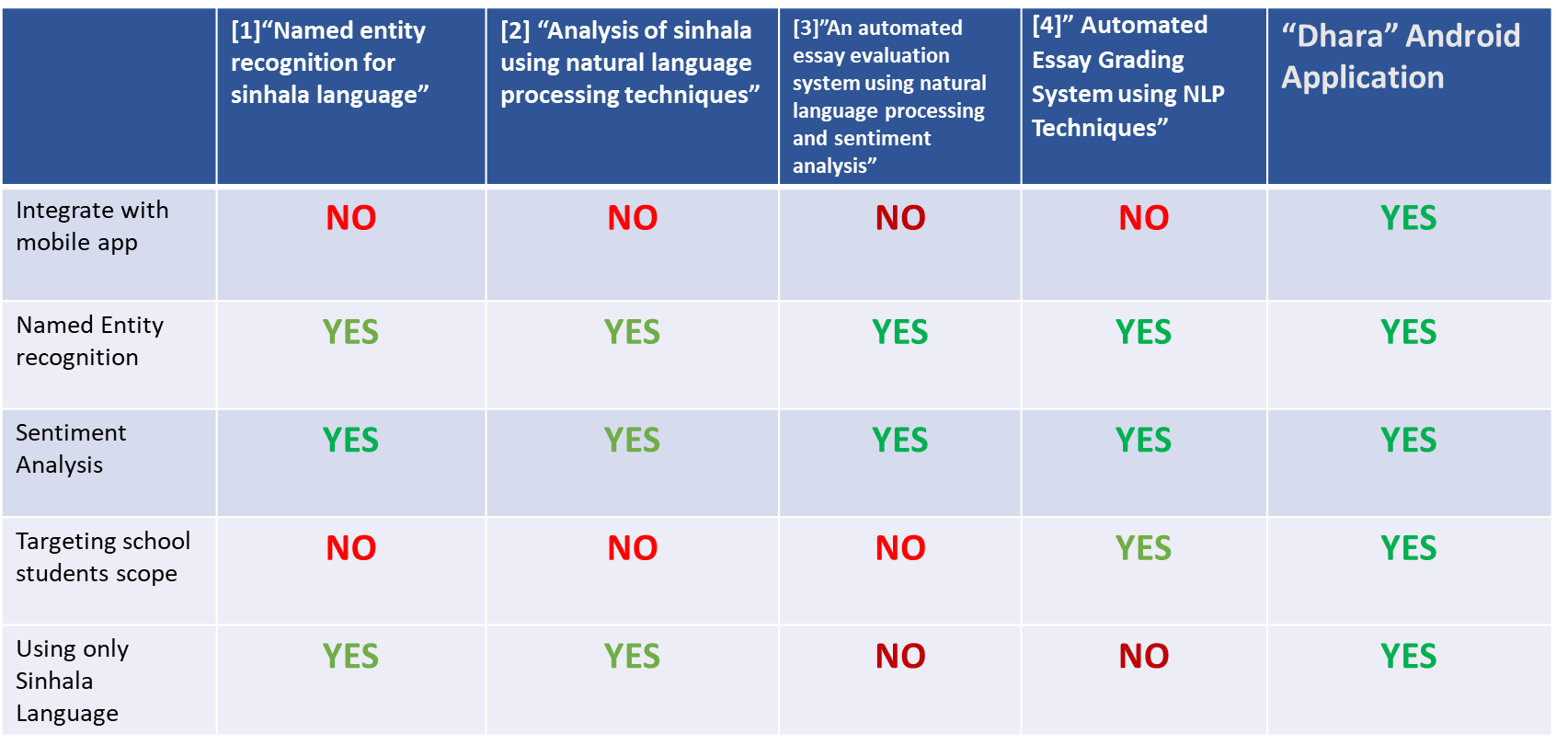
Research Gap
IT21007538 | Maddumage P.W. | R24-088
11

Slide 12
Research Question
"How to identify native words in Sinhala and replace them with general words ?”
IT21007538 | Maddumage P.W. | R24-088
12

Slide 13
Specific and sub objectives
Specific Objective
Identifying native words and replace them with generic words
Sub Objectives
Making data corpus specific to Sinhala native words
Identifying entities of the names and nouns (NER)
IT21007538 | Maddumage P.W. | R24-088
13

Slide 14
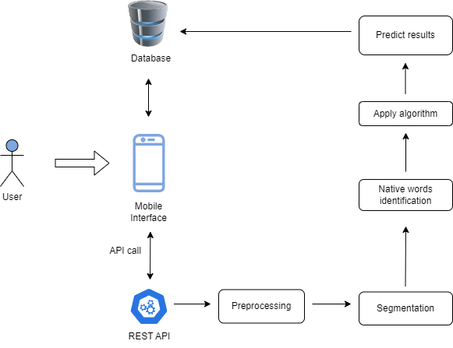
Methodology
Component Overview Diagram
IT21007538 | Maddumage P.W. | R24-088
14

Slide 15

COMPONET SPECIFIC REQUIREMENTS
Functional Requirements
User Authentication and Authorization
Native Word Identification
Generic Word Replacement
Non-Functional Requirements
Compatible to any smart device
Processing speed
Reliability
Availability
Accuracy
IT21007538 | Maddumage P.W. | R24-088
15

Slide 16



TECHNOLOGY INVOLVED
Python
NLP libraries
MySql
Tensorflow
Flask
ReactJs
Docker
Git
AWS
IT21007538 | Maddumage P.W. | R24-088
16

Slide 17
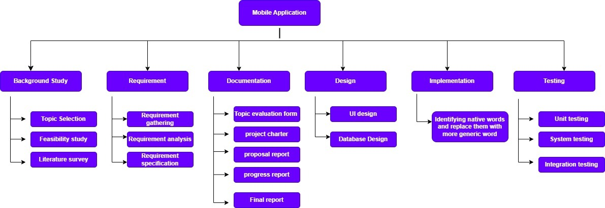
Work breakdown diagram
IT21007538 | Maddumage P.W. | R24-088
17

Slide 18
References
[1] J. K. Dahanayaka and A. R. Weerasinghe, “Named entity recognition for Sinhala Language,” in Advances in ICT for Emerging Regions (ICTer), 2014 International Conference, 2014, pp. 215–220
[2] S. Gallege, “Analysis of sinhala using natural language processing techniques,” 2010.
[3] Vijaya Shetty, SKadagathur Raghavendra, Rao GuruvyasPranav, Prashantha PatilShow and Gunakimath Suryakanth, “An automated essay evaluation system using natural language processing and sentiment analysis,” December 2022
[4] Kaushal Yadav, “Automated Essay Grading System using NLP Techniques,” International Journal of Engineering and Advanced Technology, 2020
IT21007538 | Maddumage P.W. | R24-088
18

Slide 19
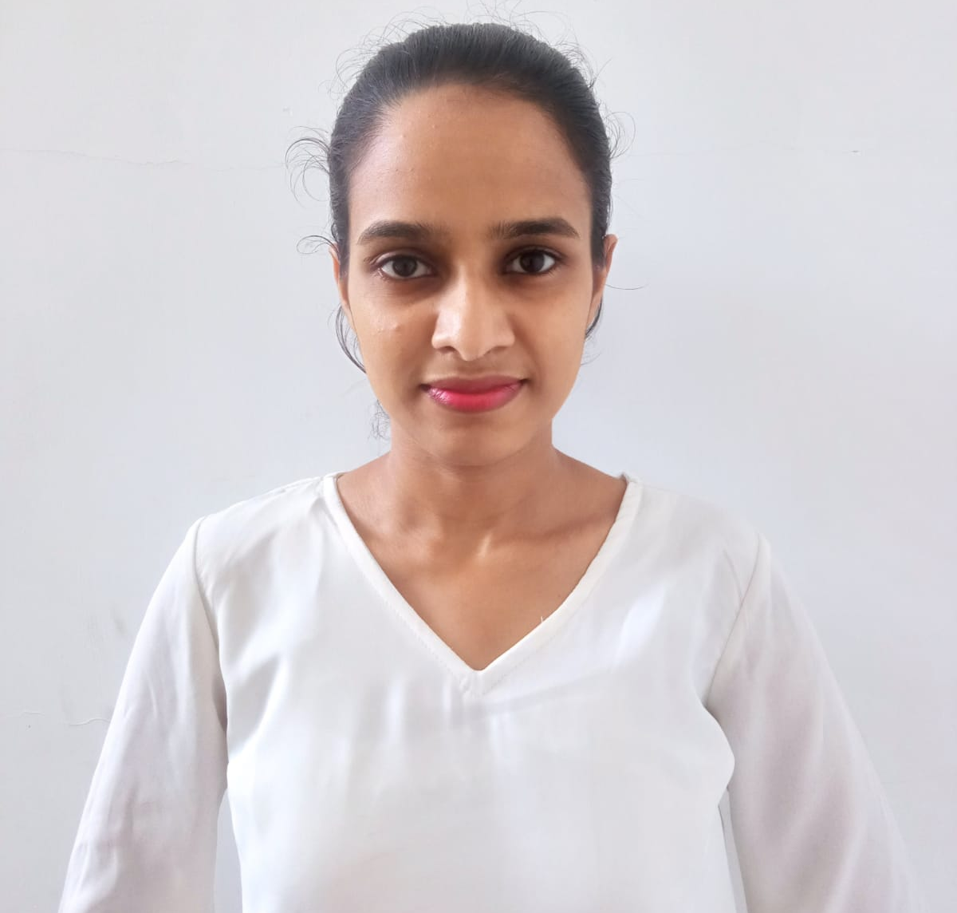
IT21006098 | Wijesinghe W.M.C.I.
BSc (Hons) Degree in Information Technology (specialization in Information technology)
IT21006098 | Wijesinghe W.M.C.I. | R24-088
19

Slide 20
Misspelled Words Detection and Correction
Component 2
IT21006098 | Wijesinghe W.M.C.I. | R24-088
20

Slide 21
Background
Goal is to help Grade 5 scholarship students improve their Essay writing skills
Focusing on detecting and fixing misspelled words in the essay
Correct spellings is essential for a good grade
IT21006098 | Wijesinghe W.M.C.I. | R24-088
21

Slide 22
Research Gap
 | [1] “Language model-based spell-checker for sri lankan names and addresses” | [2] “Erroff: A Tool to Identify and Correct Real-word Errors in Sinhala Documents” | [3”An automated essay scoring systems: a systematic literature review” | [4] ”Design of English Intelligent Simulated Paper Marking System” | “Dhara” Android Application
Integrate with mobile app | NO | NO | NO | NO | YES
Spell checking | YES | YES | YES | YES | YES
Correct Spellings | NO | YES | YES | NO | YES
Targeting school students scope | NO | NO | NO | YES | YES
Using only Sinhala Language | YES | YES | NO | NO | YES
IT21006098 | Wijesinghe W.M.C.I. | R24-088
22

Slide 23
Research Question
How to detect misspelled words and correct them ?
IT21006098 | Wijesinghe W.M.C.I. | R24-088
23

Slide 24
Specific Objective
Misspelled Words Detection and Correction
Sub Objectives
Create a word corpus for Misspelled Words of Sinhala Language
Specific and sub objectives
IT21006098 | Wijesinghe W.M.C.I. | R24-088
24

Slide 25
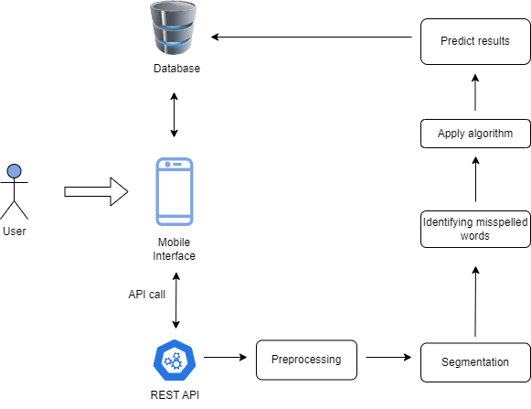
Methodology
Component Overview Diagram
IT21006098 | Wijesinghe W.M.C.I. | R24-088
25

Slide 26

COMPONET SPECIFIC REQUIREMENTS
Functional Requirements
Input Processing
Misspelled Word Identification
Categorization
Non-Functional Requirements
Performance
Processing speed
Reliability
Availability
Accuracy
IT21006098 | Wijesinghe W.M.C.I. | R24-088
26

Slide 27




TECHNOLOGY INVOLVED
Python
NLP libraries
MySql
Tensorflow
Flask
ReactJs
Docker
Git
AWS
IT21006098 | Wijesinghe W.M.C.I. | R24-088
27

Slide 28
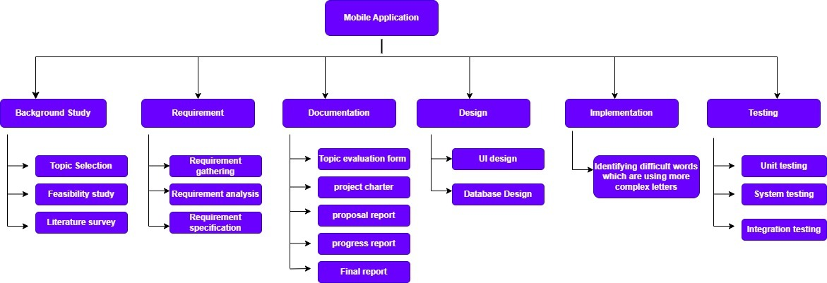
Work breakdown diagram
IT21006098 | Wijesinghe W.M.C.I. | R24-088
28

Slide 29
References
[1] Y. Udagedara, B. Elikewela, and U. Thayasivam, “Language model-based spell-checker for sri lankan names and addresses,” in 2022 Moratuwa Engineering Research Conference (MERCon). 2022, pp. 1–6
[2] P. Sudesh, D. Dashintha, R. Lakshan, and G. Dias, “Erroff: A Tool to Identify and Correct Real-word Errors in Sinhala Documents,” in 2022 Moratuwa Engineering Research Conference (MERCon). 2022, pp. 1–6.
[3] D. Ramesh and S. K. Sanampudi, “An automated essay scoring systems: a systematic literature review,” Artificial Intelligence Review, 2021, vol. 55, pp. 2495–2527
[4] L. Yang and W. Liu, “Design of English Intelligent Simulated Paper Marking System,” Complexity, vol. 2021, pp. 1–10
IT21006098 | Wijesinghe W.M.C.I. | R24-088
29

Slide 30
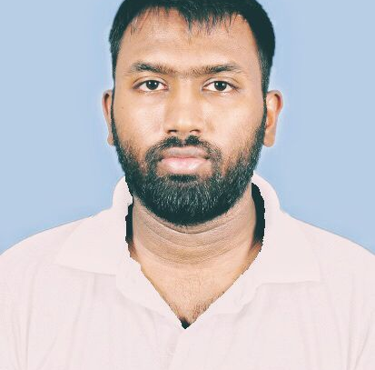
IT20604394 | Amarasena J.H.T.
BSc (Hons) Degree in Information Technology (specialization in Information Technology)
IT20604394 | Amarasena J.H.T. | R24-088
30

Slide 31
Check the Grammar rules in the sentence
Component 3
IT20604394 | Amarasena J.H.T. | R24-088
31

Slide 32
Check the grammar mistakes and correcting them
Background
IT20604394 | Amarasena J.H.T. | R24-088
32

Slide 33
Research Gap
 | [1] “Computational model for detecting grammatical mistakes in Sinhala text” | [2] “Grammatical error detection and correction model for sinhala language sentences” | [3] ” Automated essay evaluation based on fusion of fuzzy ontology and latent semantic analysis” | [4]”An automated system for scoring short answers” | “Dhara” Android Application
Integrate with mobile app | NO | NO | NO | NO | YES
Detecting grammatical mistakes | YES | YES | YES | YES | YES
Grammatical error detection and correction | NO | YES | YES | YES | YES
Targeting school students scope | NO | NO | NO | YES | YES
Using only Sinhala Language | YES | YES | NO | NO | YES
IT20604394 | Amarasena J.H.T. | R24-088
33

Slide 34
How to identify the grammatical error in the sentence?
Research Question
IT20604394 | Amarasena J.H.T. | R24-088
34

Slide 35
Specific Objective
Check the Grammar rules in the sentence
Sub Objectives
Grammar Rule Identification
Correcting grammar mistakes
Specific and sub objectives
IT20604394 | Amarasena J.H.T. | R24-088
35

Slide 36

Methodology
Component Overview Diagram
IT20604394 | Amarasena J.H.T. | R24-088
36

Slide 37

COMPONET SPECIFIC REQUIREMENTS
Functional Requirements
Grammar Rule Identification
Sentence Structure Analysis
Error Categorization
Non-Functional Requirements
Performance
Processing speed
Reliability
Availability
Accuracy
IT20604394 | Amarasena J.H.T. | R24-088
37

Slide 38


Python
NLP libraries
MySql
Tensorflow
Flask
ReactJs
Docker
Git
AWS
IT20604394 | Amarasena J.H.T. | R24-088
38

Slide 39
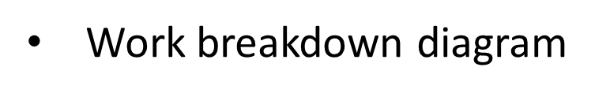
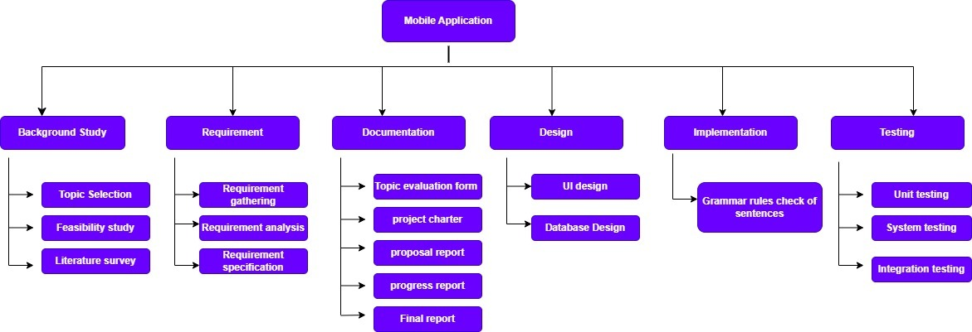
IT20604394 | Amarasena J.H.T. | R24-088
39

Slide 40

References
[1] H. M. U. Pabasara and S. Jayalal, “Computational model for detecting grammatical mistakes in sinhala text,” in 9TH YSF SYMPOSIUM, 2020, p. 255.
[2] H. M. U. Pabasara and S. Jayalal, “Grammatical error detection and correction model for sin hala language sentences,” in 2020 International Research Conference on Smart Computing and Systems Engineering (SCSE). IEEE, 2020, pp. 17–24.
[3] Darwish SM and Mohamed SK , “Automated essay evaluation based on fusion of fuzzy ontology and latent semantic analysis,” The International Conference on Advanced Machine Learning Technologies and Applications, 2020
[4] Kumar, Y., Aggarwal, S., Mahata, D., Shah, R. R., Kumaraguru, P., & Zimmermann R., Get it scored using autosas—an automated system for scoring short answers. In Proceedings of the AAAI Conference on Artificial Intelligence (Vol. 33, No. 01, pp. 9662–9669), July 2019.
IT20604394 | Amarasena J.H.T. | R24-088
40

Slide 41
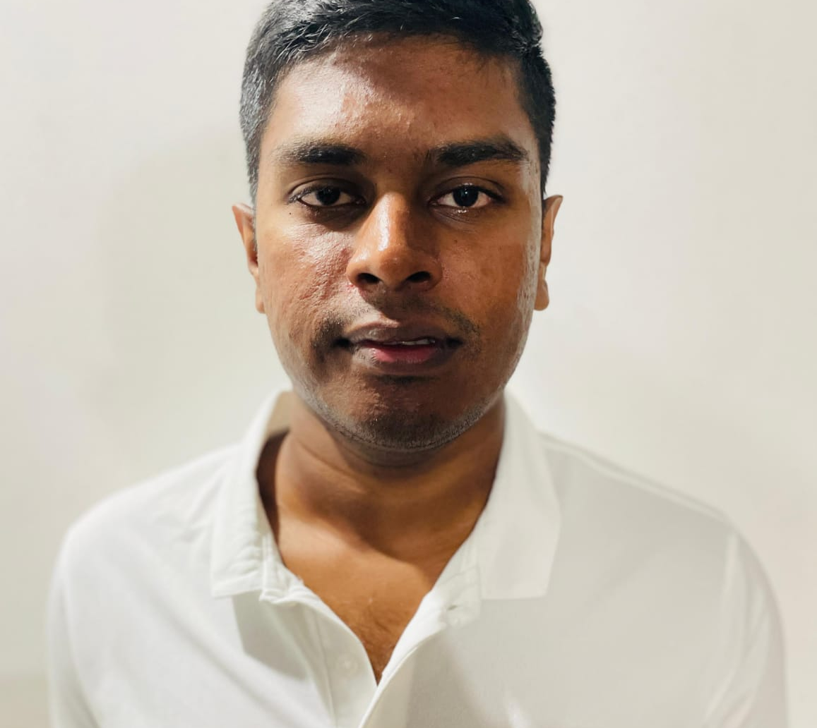
IT20124144 | Pindeniya P.C.M.
BSc (Hons) Degree in Information Technology (specialization in Information Technology)
IT20124144 | Pindeniya P.C.M. | R24-088
41

Slide 42
Evaluate generalized answer
Component 4
IT20124144 | Pindeniya P.C.M. | R24-088
42

Slide 43
Background
Comparing the keywords of the entered essay with the keywords of the system.
Marking for student's answer.
IT20124144 | Pindeniya P.C.M. | R24-088
43

Slide 44
Research Gap
 | [1] “Sinsense-word sense disambiguation tool for sinhala language” | [2] “Collecting image annotations using amazon’s mechanical turk” | [3]”Automated Essay Scoring System using Multi-Model Machine Learning” | [4]”Scoring summaries using recurrent neural networks ” | “Dhara” Android Application
Integrate with mobile app | NO | NO | NO | NO | YES
Word Sense Disambiguation | YES | YES | YES | YES | YES
Keyword extraction | YES | YES | YES | YES | YES
Targeting school students scope | NO | NO | NO | YES | YES
Using only Sinhala Language | YES | YES | NO | NO | YES
IT20124144 | Pindeniya P.C.M. | R24-088
44

Slide 45
Research Question
How to evaluate generalized answer?
IT20124144 | Pindeniya P.C.M. | R24-088
45

Slide 46
Specific Objective
Evaluate generalized answer
Sub Objectives
Defining the keywords in the essay and comparing them with the keywords in the system.
Awarding marks as the final result to the entered essay
Specific and sub objectives
IT20124144 | Pindeniya P.C.M. | R24-088
46

Slide 47
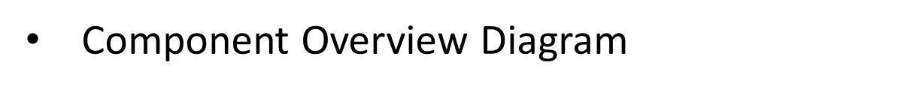

Methodology
IT20124144 | Pindeniya P.C.M. | R24-088
47

Slide 48

COMPONET SPECIFIC REQUIREMENTS
Functional Requirements
Keywords identification
Automated Evaluation
Feedback Generation
Non-Functional Requirements
Performance
Scalability
Reliability
Accuracy
IT20124144 | Pindeniya P.C.M. | R24-088
48

Slide 49
Python
NLP libraries
MySql
Tensorflow
Flask
ReactJs
Docker
Git
AWS
IT20124144 | Pindeniya P.C.M. | R24-088
49

Slide 50

IT20124144 | Pindeniya P.C.M. | R24-088
50

Slide 51
References
[1] T. Subasingha, “Sinsense-word sense disambiguation tool for sinhala language,” Ph.D. dissertation, 2020
[2] C. Rashtchian, P. Young, M. Hodosh, and J. Hockenmaier, “Collecting image annotations using amazon’s mechanical turk,” in Proceedings of the NAACL HLT 2010 workshop on creating speech and language data with Amazon’s Mechanical Turk, 2010, pp. 139–147.
[3] ‌W. Zhu and Y. Sun, “Automated Essay Scoring System using Multi-Model Machine Learning,” Computer Science & Information Technology (CS & IT), Oct. 2020
[4] Ruseti S, Dascalu M, Johnson AM, McNamara DS, Balyan R, McCarthy KS and Trausan-Matu, “Scoring summaries using recurrent neural networks,” In: International Conference on Intelligent Tutoring Systems, 2020, p 191–201.
IT20124144 | Pindeniya P.C.M. | R24-088
51

Slide 52

7.System Requirements
Personal requirements
Students
Teachers
Parents
Software requirements
User-end
Android version 5 or above
Sinhala keyboard
Developer-end
Android studio
TensorFlow v2.0
Python v3.7
SQLite
Hardware requirements
User Mobile Touch Screen
Non-functional Requirements
Reliability
Security
Performance
Usability
Availability
52

Slide 53
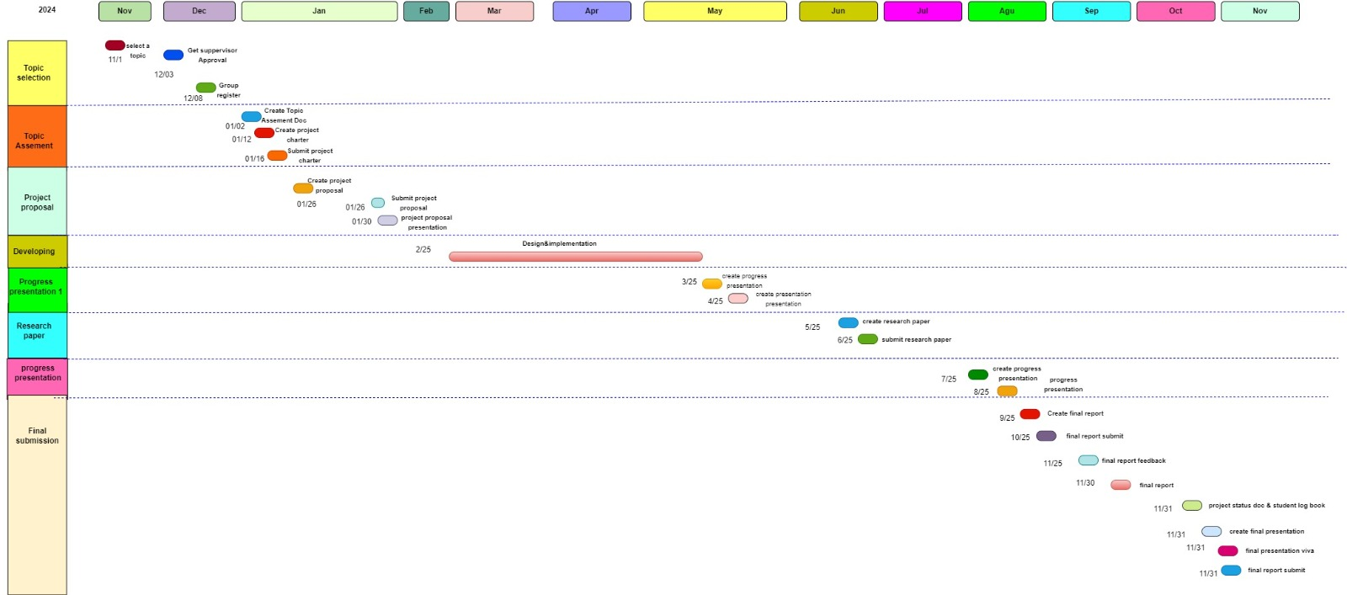
8.Gantt Chart
53

Slide 54

9.Commercialization Aspects
Social Media Commercialization
Provide low-cost subscription plans considering each side as,
- Free subscription for children orphanages
- Low cost subscription for government schools
- Relatedly high cost subscription for international schools
54

Slide 55
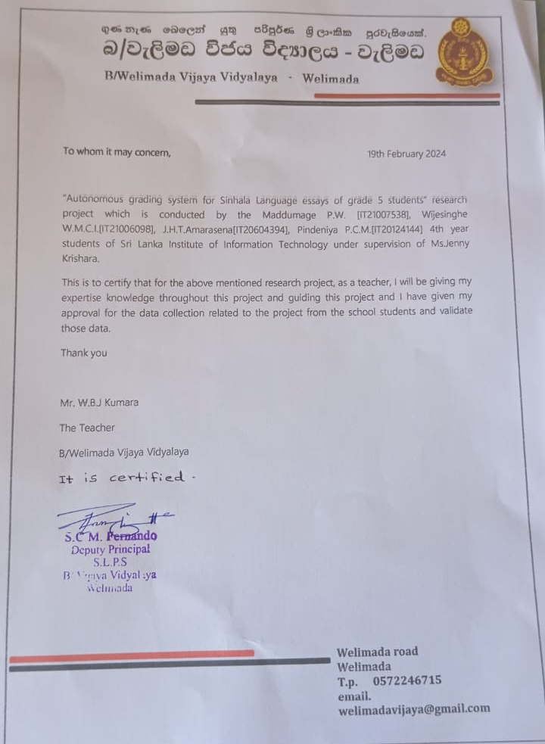
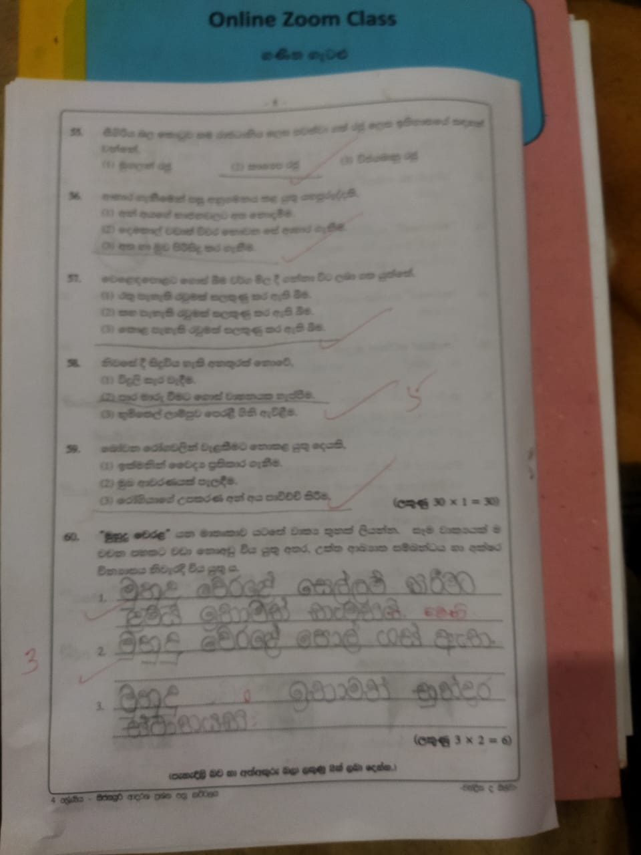
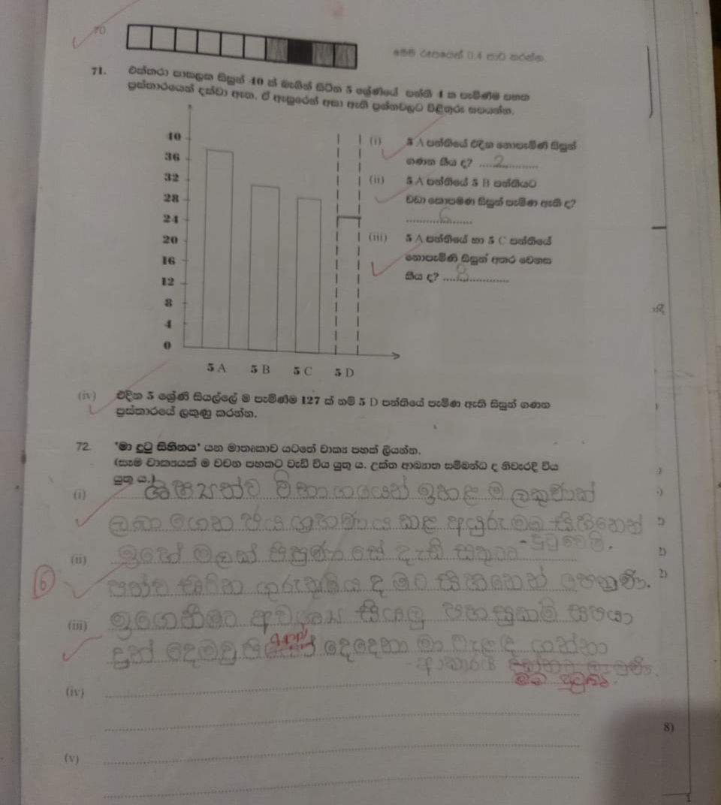
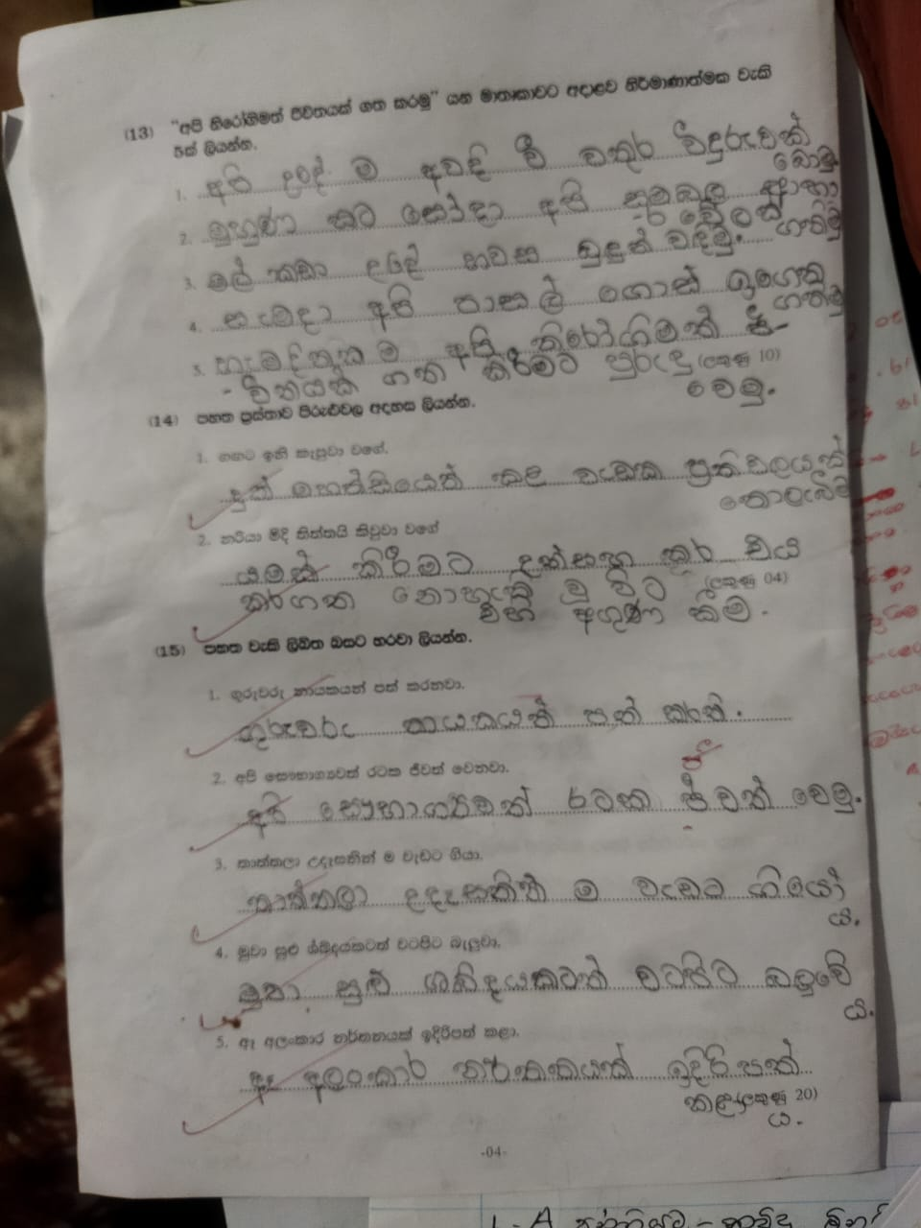
10.Appendix
55

Slide 56
THANK YOU
56

